Slide 1

Basic of Marketing

Slide 2
What is Marketing
Simple definition: Marketing is the management process responsible for identifying, anticipating, and satisfying customer requirements profitably.” (CIM,2001)
Goals:
Attract new customers by promising superior value.
Keep and grow current customers by delivering satisfaction.

Slide 3
Marketing Defined
Marketing is the activity, set of instructions, and processes for creating, communicating, delivering, and exchanging offerings that have value for customers, clients, partners, and society at large.
OLD view of marketing:
Making a sale—“telling and selling”
NEW view of marketing:
Satisfying customer needs
Notes:
This has come about, in part, due to the business paradigm shift experienced in many markets.
In New Markets, we tend to talk about sellers markets- the seller has the power- demand outstrips demand.

Slide 4
Why is Marketing Important?
Shifting Business Paradigms
Buyers’ markets
Sellers’ markets

Slide 5
Product Orientation vs. Marketing Orientation
Company | Product | Marketing
Xerox | We make copying equipment | We improve office productivity
Columbia Pictures | We make movies | We entertain people
Encyclopedia Britannica | We sell encyclopedias | We distribute information
Carrier | We make air conditioners and furnaces | We provide climate control inside homes

Slide 6
The marketing orientation
The marketing concept is the view that an organization’s ability to sell its products and services depends upon the effective identification of consumer needs and wants and a successful determination of how best to satisfy them

Slide 7
The Marketing Process
A simple model of the marketing process:
Understand the marketplace and customer needs and wants.
Design a customer-driven marketing strategy.
Construct an integrated marketing program that delivers superior value.
Build profitable relationships and create customer delight.
Capture value from customers to create profits and customer quality.

Slide 8
Needs, Wants, and Demands
Need: State of felt deprivation including physical, social, and individual needs.
Physical needs: Food, clothing, shelter, safety
Social needs: Belonging, affection
Individual needs: Learning, knowledge, self-expression
Want: Form that a human need takes, as shaped by culture and individual personality.
Wants + Buying Power = Demand

Slide 9
Need/ Want Fulfillment
Needs & wants are fulfilled through a Marketing Offering:
Products:Persons, places, organizations, information, ideas.
Services:
Activity or benefit offered for sale that is essentially intangible and does not result in ownership.
Experiences:
Consumers live the offering.

Slide 10
Customer Value and Satisfaction
Dependent on the product’s perceived performance relative to a buyer’s expectations.
Care must be taken when setting expectations:
If performance is lower than expectations, satisfaction is low.
If performance is higher than expectations, satisfaction is high.
Customer satisfaction often leads to consumer loyalty.
Some firms seek to DELIGHT customers by exceeding expectations.

Slide 11
Marketing Management
The art and science of choosing target markets and building profitable relationships with them.
Requires that consumers and the marketplace be fully understood.
Aim is to find, attract, keep, and grow customers by creating, delivering, and communicating superior value.

Slide 12
Marketing Management
Marketing managers must consider the following, to ensure a successful marketing strategy:
What customers will we serve?
— What is our target market?
How can we best serve these customers?
— What is our value proposition?

Slide 13
Marketing Management Involves:
Demand Management : The organization has a desired level of demand for its products. At any point in time, There may be no demand, adequate demand, irregular demand, or too much demand, and marketing management must find ways to deal with these different demand states.
Building Profitable Customer Relationships : Beyond designing strategies to attract new customers and create transactions with them, companies now are striving to retain current customers and build lasting customer relationships.

Slide 14
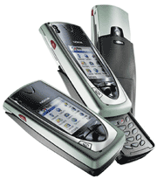


Why marketing it needed?
millions of new products are launched:
Without careful marketing these products would fail

Slide 15
Dimensions That Define a Business
Customer
groups
Customer
needs
Technology

Slide 16
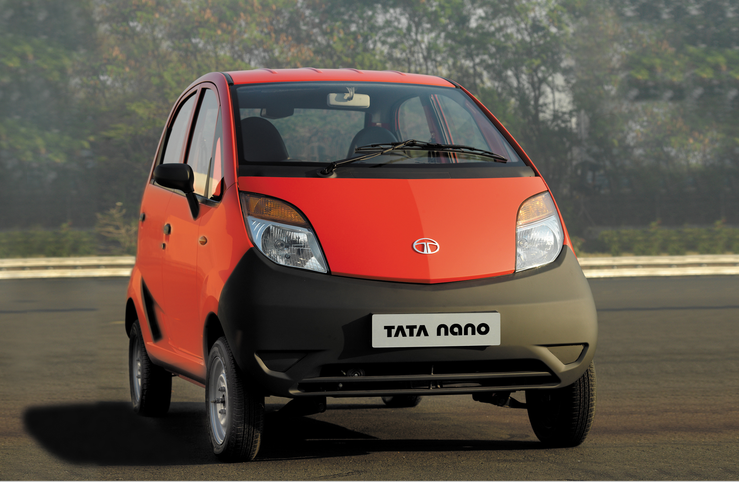
Developing the People’s Car ‘TATA Nano’

Slide 17
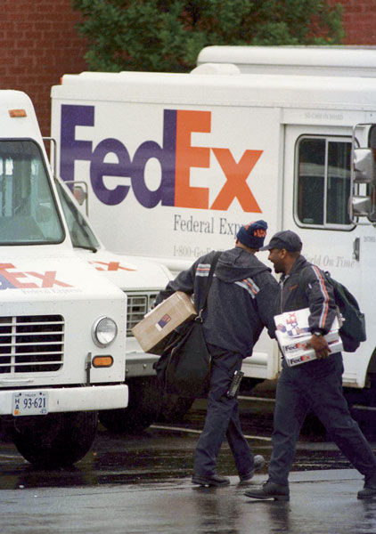
FedEx
FedEx added Sunday deliveries
based on customer requests and
market demand

Slide 18
Societal Marketing Concept
The idea that the organization should determine the needs, wants, and interests of target markets and deliver the desired satisfactions more effectively and efficiently than competitors in a way that maintains or improves the consumer’s and society’s well – being.

